Slide 1


Slide 2




m-Cubes: An efficient and portable implementation of multi-dimensional integration for GPUs
Ioannis Sakiotis, Kamesh Arumugam, Marc Paterno, Desh Ranjan, Balsa Terzic, Mohammad Zubair

Slide 3
Multi-dimensional Numerical Integration
Applications: parameter estimation, simulation of beam dynamics, risk management, ray-tracing
Deterministic, probabilistic
No algorithm guarantees the accuracy of its estimated results
Specify desired accuracy
Evaluate accuracy
Goal: bring efficient Monte Carlo integration to GPUs

Slide 4
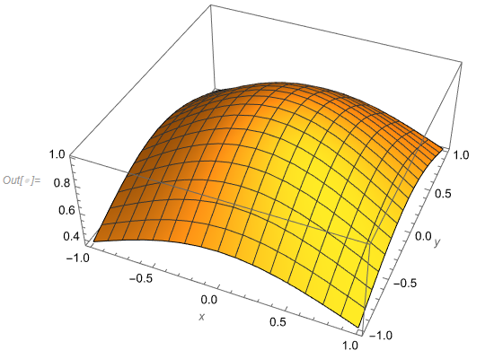
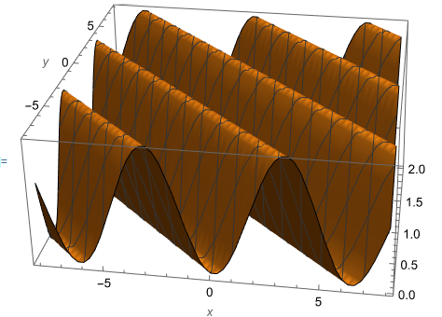
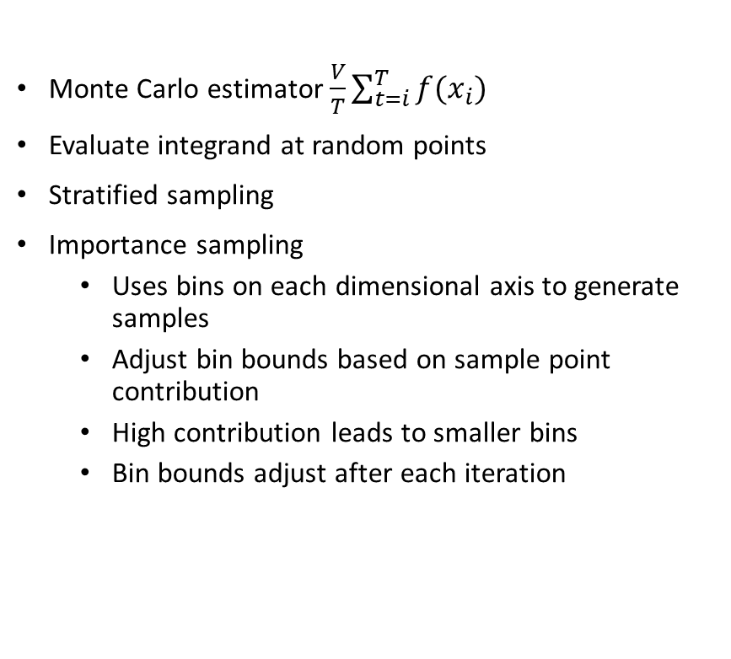
VEGAS
Monte Carlo estimator $\frac{V}{T}\sum_{t=i}^{T}{f(x_{i})}$
Evaluate integrand at random points
Stratified sampling
Importance sampling
Uses bins on each dimensional axis to generate samples
Adjust bin bounds based on sample point contribution
High contribution leads to smaller bins
Bin bounds adjust after each iteration

Slide 5
Existing Implementations
CPU
CUBA
GSL
Python package
GPU
gVegas
ZMCintegral

Slide 6
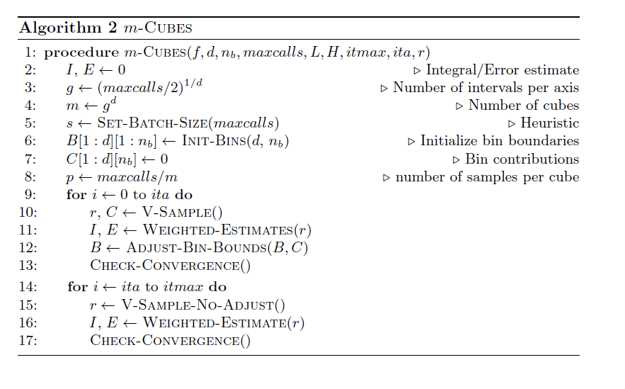
M-Cubes Algorithm
500 bins per axis
Constant amount of memory
Map thread to batch of sub-cubes
Uniform # of samples per sub-cube

Slide 7
Parallelization
Workload Balance
Constant # of samples per cube
Constant # of cubes per thread
Accumulate estimates from cubes
All Threads serially accumulate from sub-cubes
All threads: thread-block reduction
1 thread per block: Atomic-add
Accumulation of bin contributions
Data movement
Random number generation
All threads: atomic-add
CURAND Device API
On the fly generation from Device
Device: sampling
Copy to Host
Host: bin-adjustments
Copy updated bin bounds to device

Slide 8
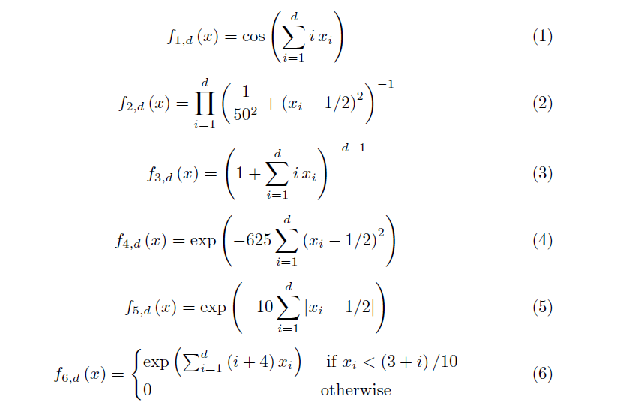
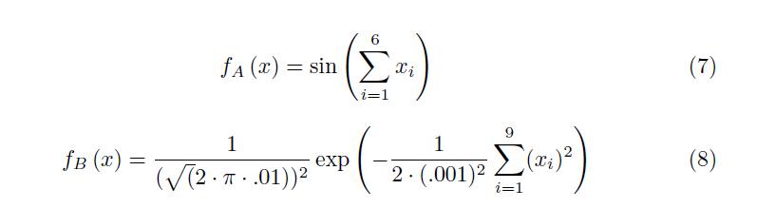
Experimental Results
Integrand test-suite with known answers
Adapting to different precision levels
100 runs per experiment
“Integrand evaluation” time negligible
V100 16 GB GPU
GCC 9.3.1
CUDA 11
Notes:
Case of fA was most extreme with 18%

Slide 9
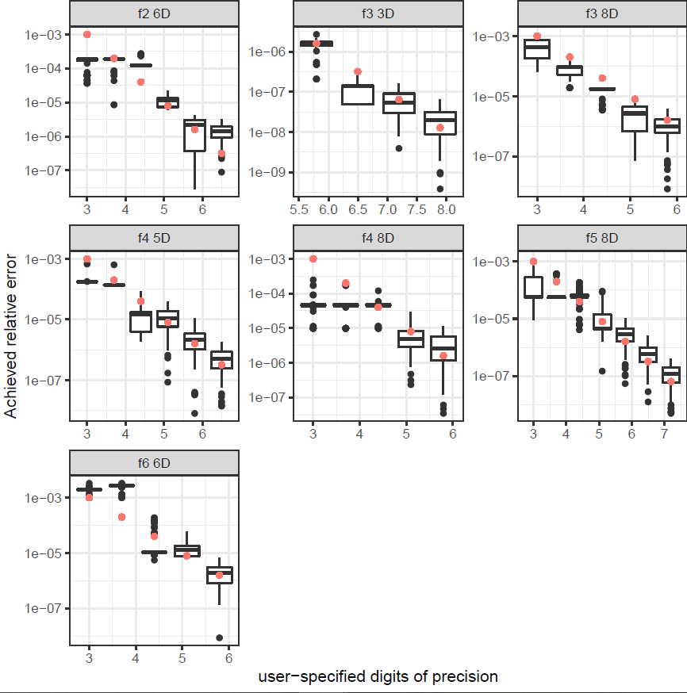
Accuracy

Slide 10
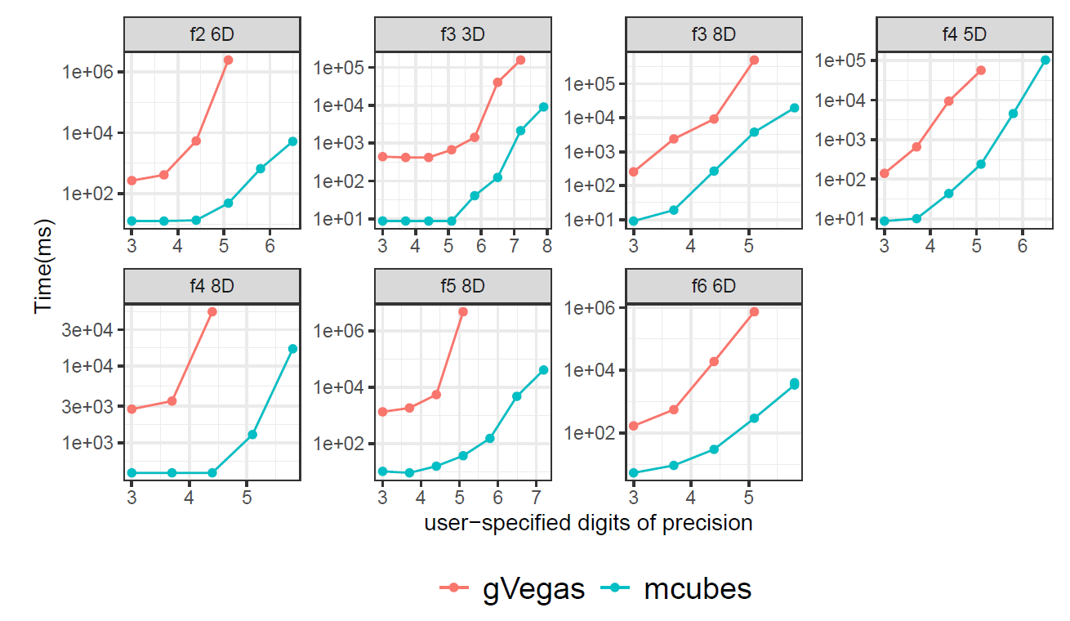
Performance
Notes:
The required number of iterations tends to increase for higher
precision runs. For low-precision runs, the same number of samples and iterations
can result in convergence. This is why for some integrands (f4;8, f5;8, f3;3, f2;6),
the three, four, and ve digits of precision runs display similar execution time.

Slide 11
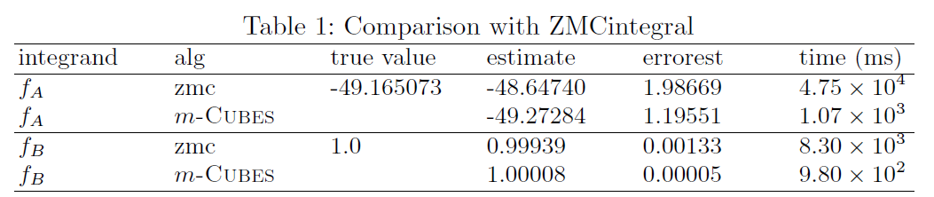
Performance

Slide 12
Ease of use
Available at https://github.com/marcpaterno/gpuintegration
Header only library
Optional build of demos
C++ 17
CUDA
Kokkos

Slide 13
Interface
class Gaussian {
public:
__device__ __host__
double
operator()(double x, double y, double z, double w)
{
double beta = .5;
return exp(-1.0 *
(pow(25., 2.) * (pow(x - beta, 2) + pow(y - beta, 2) + pow(z - beta, 2) + pow(w - beta, 2) )));
}
};
C++ object
Function arguments
Integrand
Relative/absolute error tolerances
Number of samples
Integration-space bounds
Number of iterations
Template arguments
Integrand type
Dimensionality
Gaussian integrand;
integrate<Gaussian, ndim>(integrand, epsrel, epsabs, nsamples);

Slide 14

Stateful Integrands
“Real-world” integrands can be complex
Integrand and state is copied to GPU memory
CUDA compatible computations and data-structures
Use case: cosmology integrand
Nested objects
Bilinear interpolation
Look-up tables

Slide 15
Execution platform portability
Kokkos implementation
Maintain hierarchical parallelism
10-15% overhead on parallel code
Single code

Slide 16
Conclusion
Parallel implementation of VEGAS
Superior performance over other Monte Carlo integrators
Portable and easy to use
CUDA & Kokkos implementation
Up-coming Intel oneAPI implementation

Slide 17
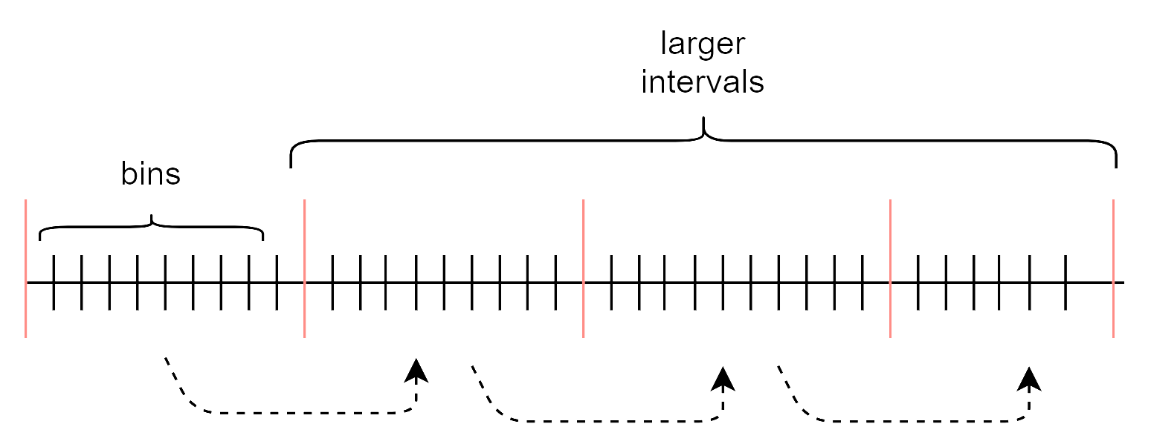
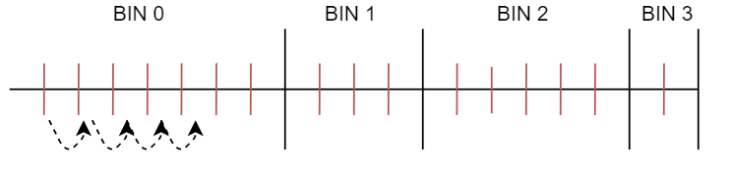
Bins and intervals

Slide 18
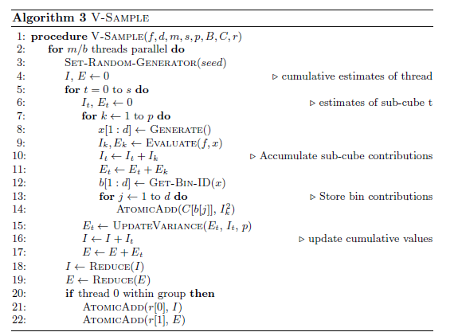
m-Cubes 1D
Bin-adjustment driven by bin-contributions
Bins of each axis processed separately
Symmetrical integrands
Bin-contributions are stored in device memory
Updated through atomic-operations
In m-Cubes 1D, process single axis
Performance gains on symmetrical integrands

